Slide 1
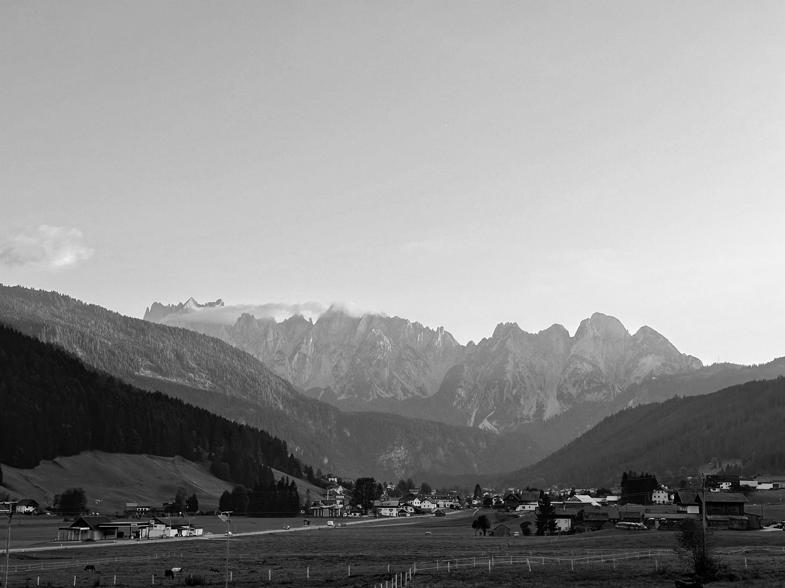

ND INNOVATION NORTH AMERICA, INC.
Member of ND Group

Slide 2

Agenda
About us
About
Milestones
Customers
Sales Strengths
Organizational Structure
Locations
Changzhou Gigafactory
Product Solutions
User Insights
R&D Innovation
Product System Matrix
Product Solutions
Core Components
Solutions
Corporate Culture
Social Responsibility
Corporate Culture
Company Sponsored Clubs

Slide 3


About
Established in 1988, to lead the global automotive seat comfort solutions.
Specialized in integrated seat & interior comfort system solutions.

Slide 4




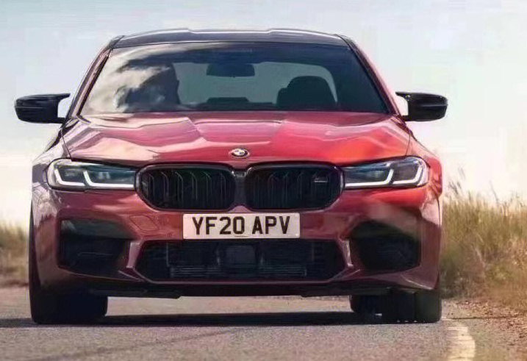
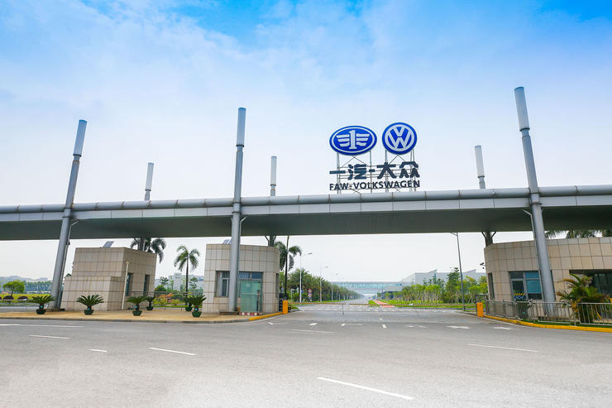




Milestones
Initial Stages
Established
Entered the automotive industry
FAW supplier
First manual lumbar support product in mass production
Faurecia/Forvia supplier
Certified with IATF 16949
Johnson (Adient) & Great Wall Motors supplier
First electric lumbar support product in mass production
BYD supplier
Magna supplier
Began global deployment
Lear Global &
Brose supplier
G38 BMW 5 Series Interior Components Designated Globally
Exceeded 100 Million in annual production value for suspension products
1988
1999
2005
2007
2009
2012
2013
2015
Notes:
初创期，谈与座椅厂的合作，李尔、安道拓、延锋、佛吉亚。Logo要显示座椅厂。
BYD不用写，第二优先级。
一级标题写座椅厂
二级小字都删掉，改成手稿
三大点：给谁供货？供了什么？供了多少？
产品重点信息（客户是谁、产值）：第一个手动腰托量产、第一个电动腰托。500万件、1000万件。比如网格有10亿件，重点突出。找郑明
补充长春工厂建立时间

Slide 5

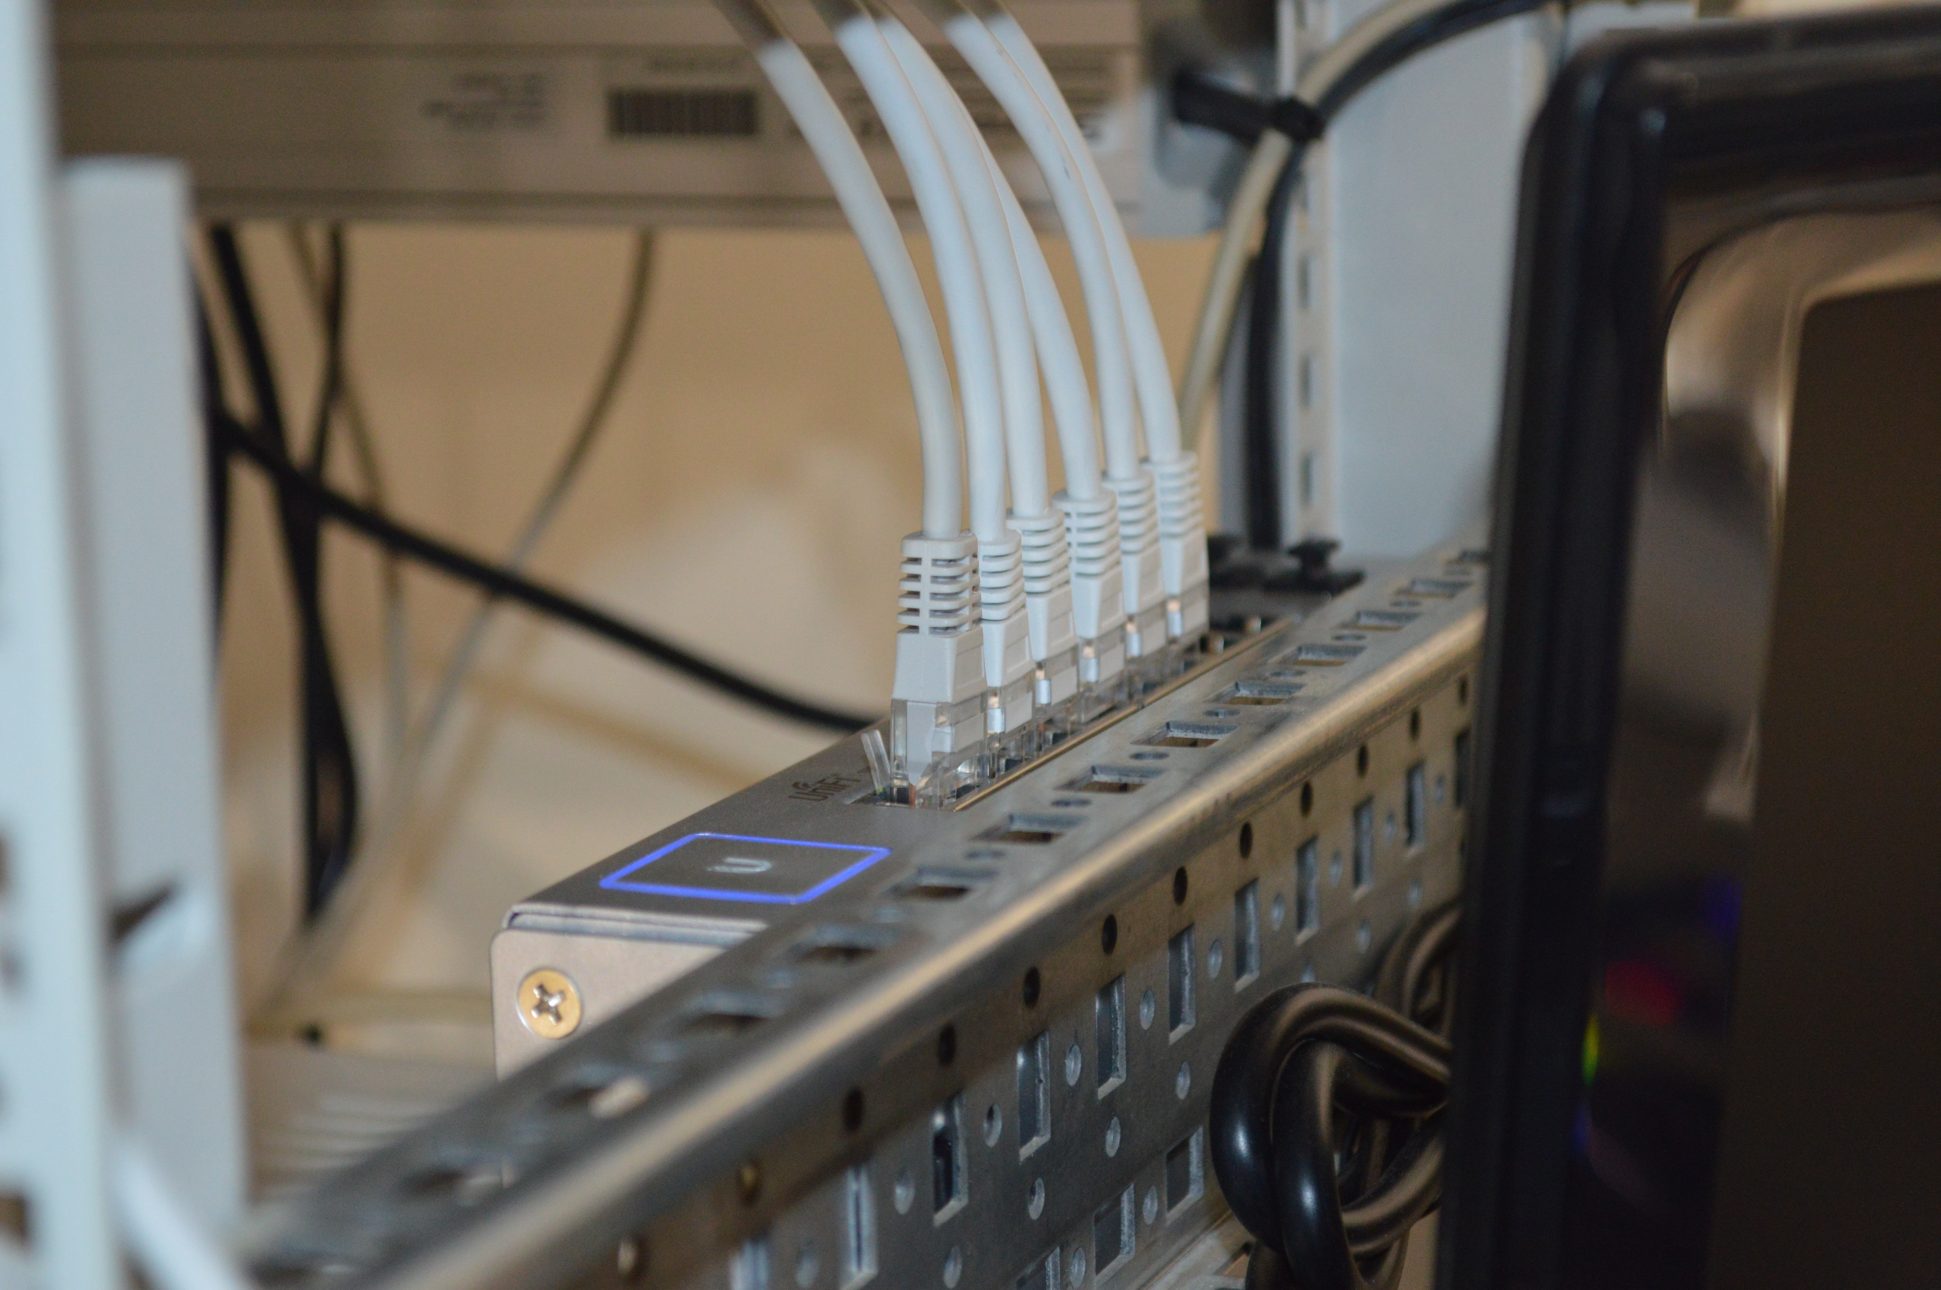
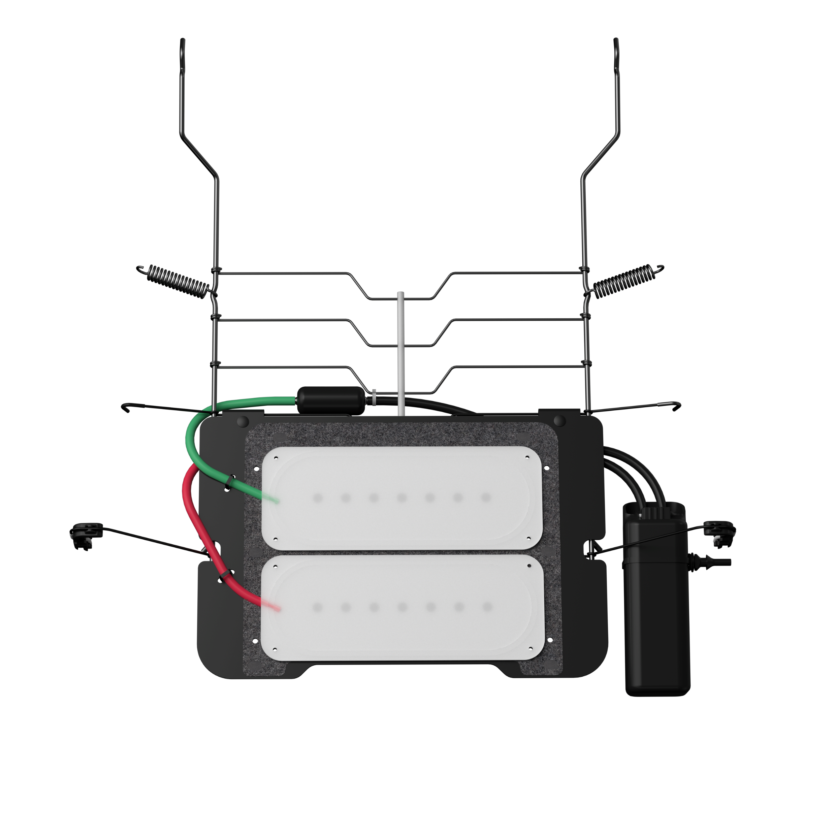
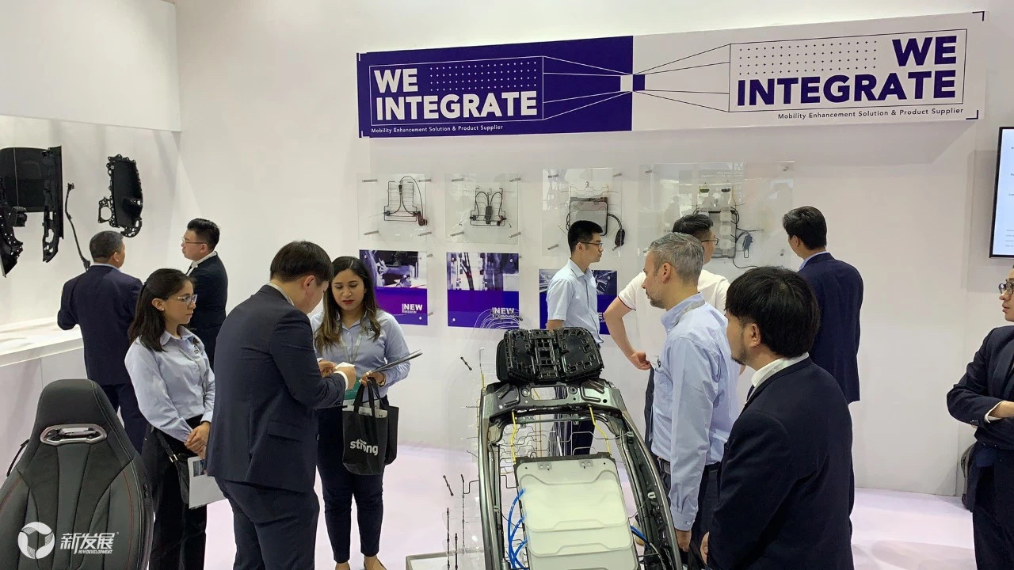

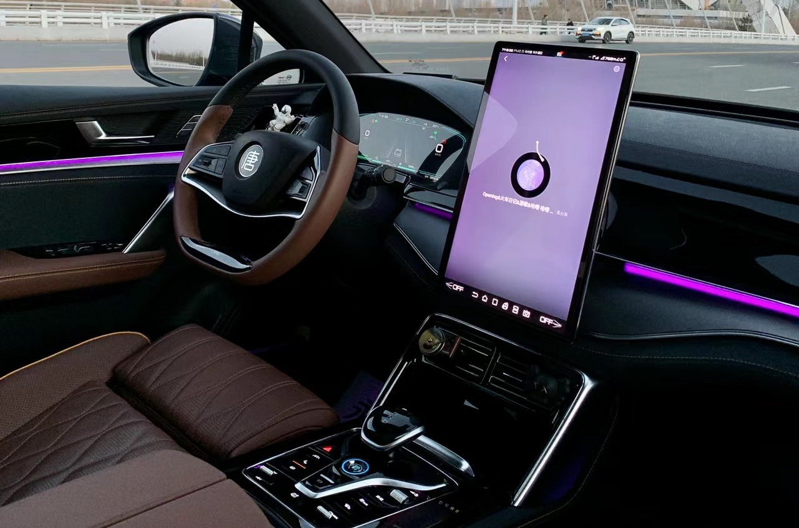
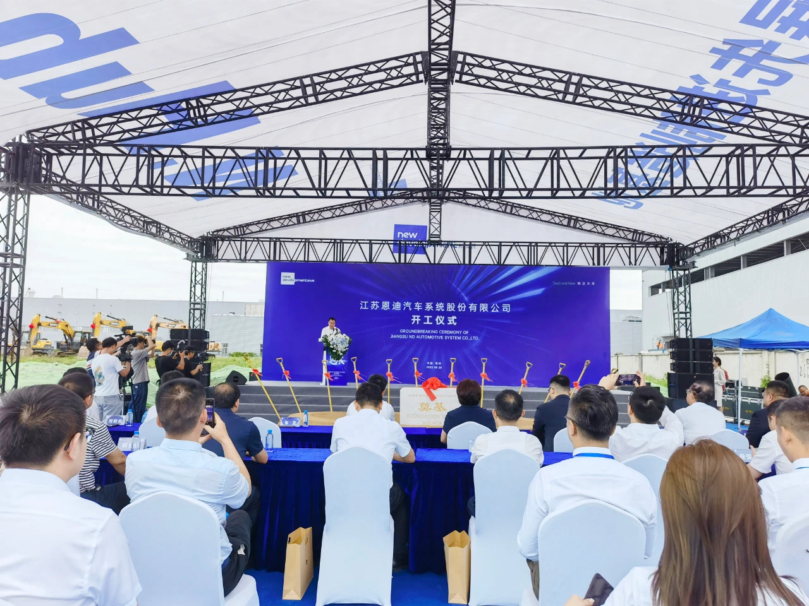
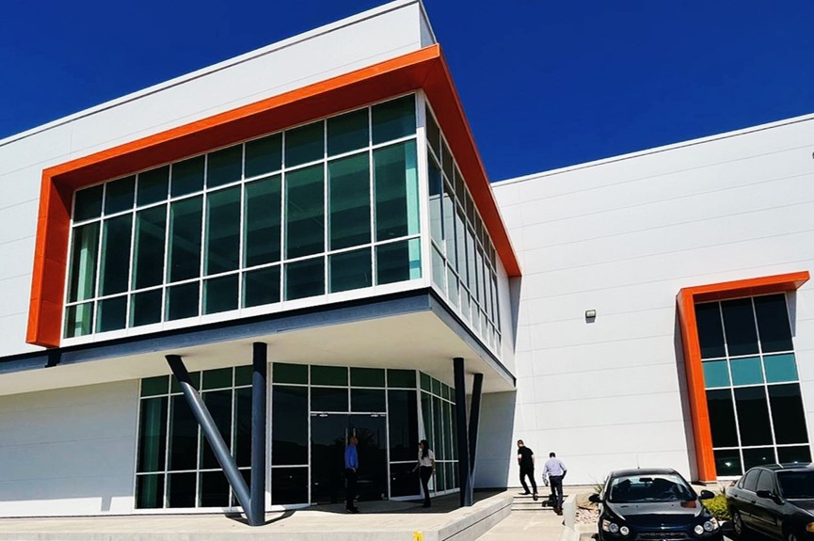
Milestones
High-Speed Development Stage
Established in-house R&D for comfort systems
First pneumatic lumbar support product in mass production
Acquired comfort system projects from CHAN, BAIC, Dongfeng &
Chery
GM supplier
Secured comfort system projects with NIO, Xpeng, GWM & Geely
Obtained international Patent Cooperation Treaty Authorization
Secured comfort system projects with BYD & GAC
Exceeded 100 million units of backrest suspension products produced
Secured comfort system projects with Xpeng & NIO
Completed North American Detroit R&D office & Mexico factory site selection
Supplier to a US EV OEM, FAW Audi New Energy & Xiaomi
2017
2018
2019
2020
2021
2022
2023

Slide 6




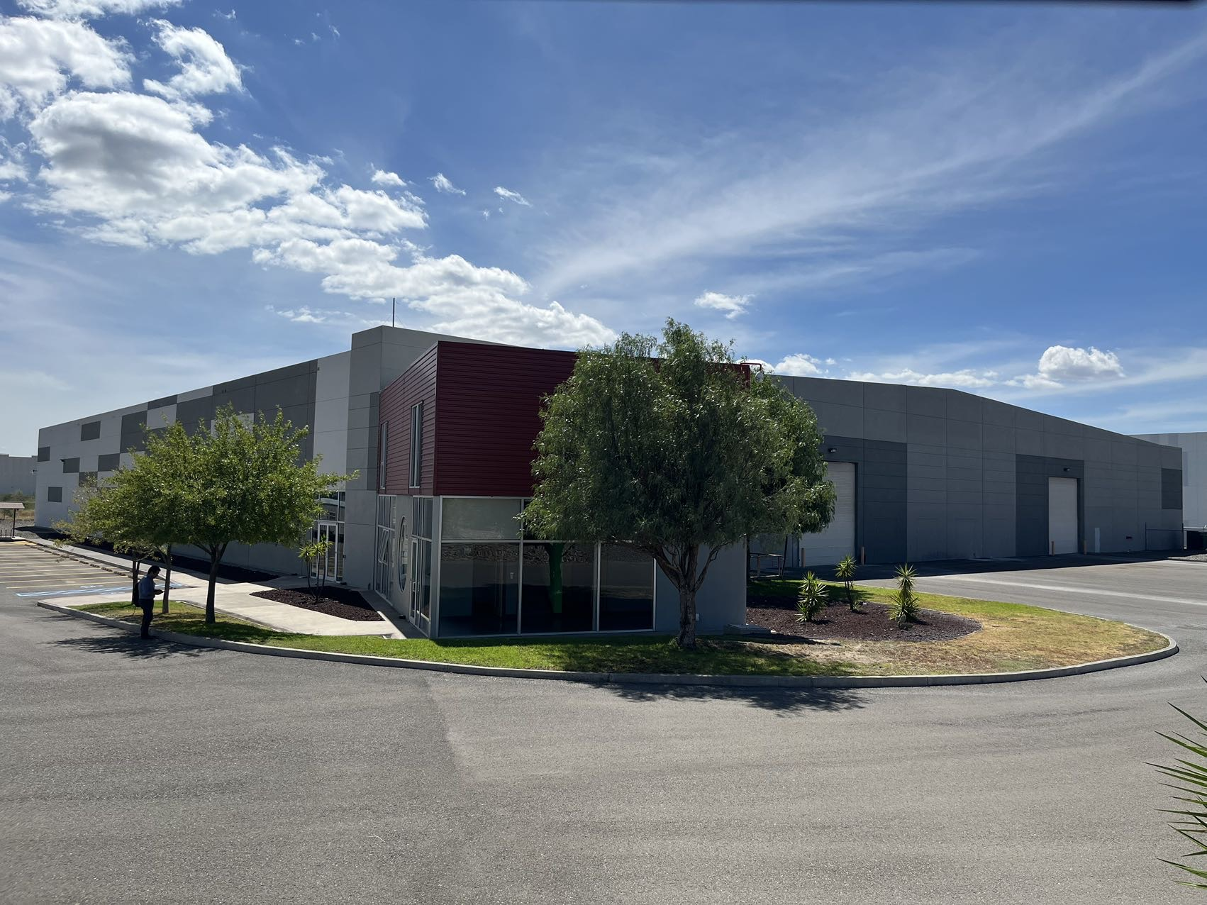
Milestones
Future Outlook
Global headquarters projected
$1.53B USD/annum
Global seat comfort market share forecasted to be 30%
IPO
2024
2025
2026
Future

Slide 7











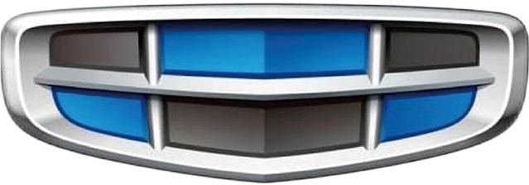



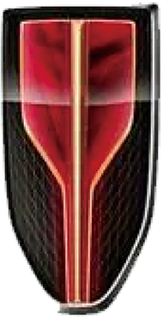

























Customers

Slide 8

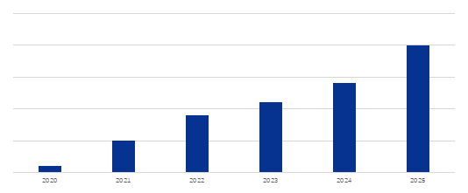
Sales Strengths
100+
50 +
Serving Clients
(OEMs + Seat Manufacturers)
Integrated Comfort System Clients
30%+
$1.4 billion (USD)
Core Products (Integrated Solutions)
Nationwide Market Share Percentage
Current Orders
$150+
35yrs
Auto ASP
(Average Selling Price)
Industry Accumulation
Revenue growth trend (in million USD)

Slide 9

Locations
Changchun
Wolfsburg
Beijing
Seoul
Detroit
Changzhou
Shanghai
North American headquarters
Engineering,Sales &Support,
Technical Centre
Detroit, USA
Aisa Pacific headquarters
Singapore City,Singapore
China headquarters
Engineering,Manufacturing&Distribution,Sales&Support
Changzhou, China
Manufacturing&Distribution
Silao, Mexico
Changchun, China
Shenzhen, China
Distribution,Sales&Support
Seoul, South Korea
Rayong, Thailand
Sales&Support
Wolfsburg, Germany
Beijing, China
Shanghai, China
Silao
Shenzhen
Rayong
Singapore City

Slide 10


Mexico Manufacturing Facility (Silao)
Number of Employees
265(2024)
Annual Value of Production
Support Cushion Systems
5 Million
Ventilation System
0.6 Million
Lumbar Support System
·Mechanical Type 5 Million
·Pneumatic Type 5 Million
Massage System
0.3 Million

Slide 11
R&D Innovation
Technical Development Capabilities
Experimental Capability
Average project duration reduced by 20%
  1,950 square meter laboratory
  CNAS accredited
  Laboratories recognized by multiple OEMs (GM,VW etc.)
300+ engineers
6% annual revenue
re-invested in R&D
300+ patents
Prototyping Capability
Engineering Capabilities
Average 3 months design to prototype
Comfort system prototyping capabilities,
with proficiency in software development
  Automated assembly
  Customized processes
  Benchmark Assessment

Slide 12

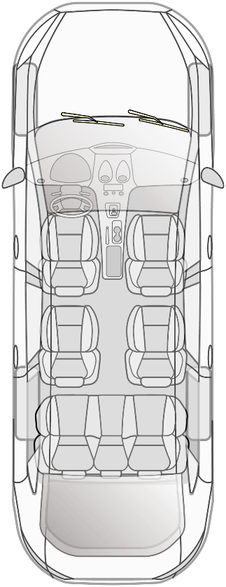
User Insights
Seat Heating
Electric Lumbar Support
Seat Ventilation
Comfort System
Memory Function
Lumbar Massage
Headrest
Pneumatic Lumbar Support
Experience the future in smart driving
with our intelligent Comfort System
Electric Adjustment

Slide 13
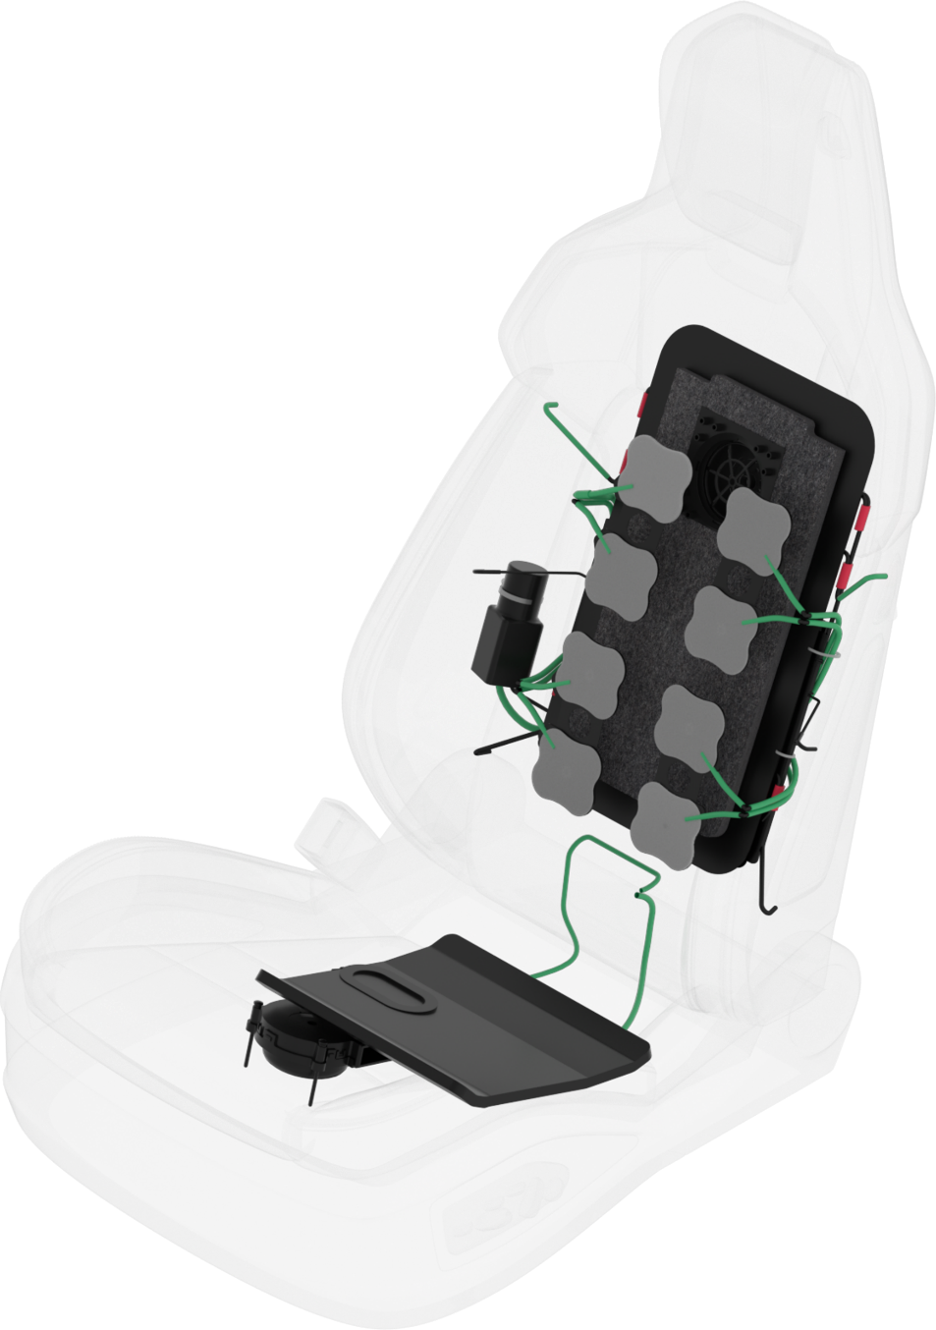
Product Solutions
Integrated Design
Suspension+Lumbar+Massage+Vent+Heating
Algorithm supporting OTA Updates
5 Massage Modes
Hyperflow Ventilation Technology
Seat with 40m³/h Airflow

Slide 14
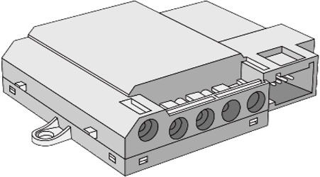
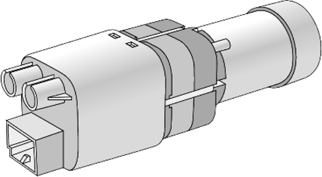
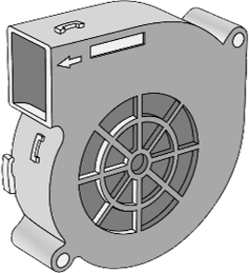
Core Components
Three Core Components (Developed In-House)
Integrated Design
Quick Response
Programmable
ECU
Pump
Diverse Design
Precision Control
High Flow Rate
Platform Design
Variable Modes
Noise Reduction Technology
Fan

Slide 15

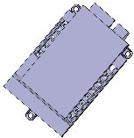
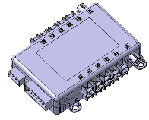

Core Components
ECU Valve details
 | ND _EP03 |  | ND _EP04 |  | ND _EP05A/C |  | ND _EP05B/D
Valve setup | 1-6 | 1-14 |  | 1-10 |  |  | 1-18
Dimensions | 85.5*70*20mm, <90g |  | 134*83*23mm, <165g |  | 99*69*23mm，＜150g | 149 x 81x 23 mm, <233g
Valve operating sound | < 35 dBA
Application | Lumbar & Massage |  | Lumbar/Massage/ Bolster |  | Lumbar/Massage/ Bolster |  | Lumbar/Massage/ Bolster
Wake-up mode | LIN/switch |  | LIN/switch |  | LIN/switch/CAN |  | LIN/switch/CAN
Static current | 0.05mA |  | 0.05mA |  | 0.08mA |  | 0.08mA
Memory | N / Y |  | N / Y |  | N / Y |  | N / Y
Inflation time recording | software logic logging |  | software logic logging |  | software+pressure sensor |  | software+pressure sensor
Benefits | Customizable massage module with regular adjustment and permanent venting functions

Slide 16
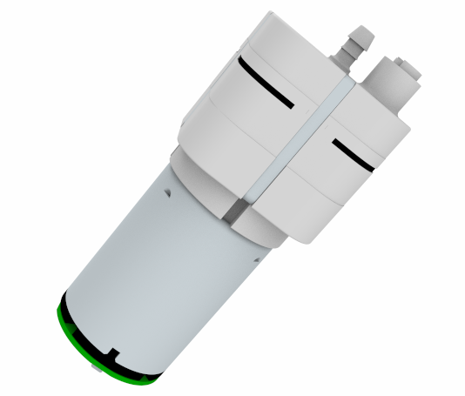
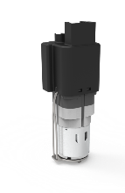
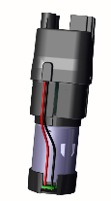
Core Components
PUMP Valve details
 | ND_P07 | ND_IPV01 | ND_IPV03
Size | 36*36*93.4mm | 38.3*40.3*129.6mm 175g | 38.3*40.3*129.6mm 188g
Valve operating sound | Load ≤ 37dB | ≤35dB A (@1000mm, Volkswagen 10-point test method)
Application | Lumbar & Massage | 2-way/4-way lumbar | 2-way/4-way lumbar
Durability | ＞1500h | ＞1500h | ＞1500h
Installation | Protective cover/Muff | （Usually ）Bagged | （Usually ）Bagged
Instruction | Lumbar Massage Product | Integrated Pump Valve Unit | Integrated Pump Valve Unit

Slide 17
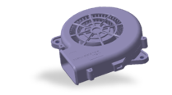
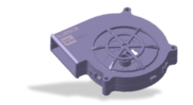
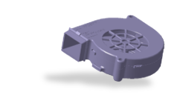
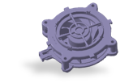
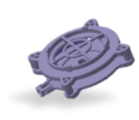
Core Components
FANS Valve details
 | ND_B01 | ND_B02 | ND_B03 | ND_F01 | ND_F02
Size | 100x 100 x 25mm, 140g±10 | 100 x 100 x 20mm, 125g±10 | 80 x 80 x22.4mm, 87g±10 | 90 x 90x 26.7mm, 130 g±10 | 90 x 90 x 21.7mm, 110 g±10
Valve operating sound | 53dBA | 55dBA | 55dBA | 44dBA | 51dBA
Functions | Blow/Suction | Blow/Suction | Blow/Suction | Suction | Suction
Rated voltage | 13.5±0.1VDC | 13.5±0.1VDC | 13.5±0.1VDC | 13.5±0.1VDC | 13.5±0.1VDC
Rated current | 600mA±20% | 550mA±20% | 400mA±20% | 250mA±20% | 400mA±20%
Operating temperature | -40~+85℃ | -40~+85℃ | -40~+85℃ | -40~+85℃ | -40~+85℃
Airflow | 19.8CFM | 18.9CFM | 13.5CFM | 29.0CFM | 29.63 CFM
Aerodynamic drag | 32.6mmH₂O | 37.0mmH₂O | 51.4mmH₂O | 15.3mmH₂O | 14.82 mmH2O
Benefits | Suitable for blowers/ventilation systems, widely applicable |  |  | Suitable for exhaust systems, high airflow, low noise

Slide 18




Social Responsibility
Ecological Smart Factory
LEED & WELL Gold Certification
Upholds green sustainability
Our Actions
Prioritizing energy efficiency
Environmental conservation
Supplier sustainability initiative
Our Commitment
Innovate with sustainable actions leading to carbon neutrality

Slide 19


Corporate Culture
Mission Enhancing the Comfort Experience in Vehicle Mobility
Vision Lead Global Automotive Cabin Seat Comfort Systems
Values BEST-Beyond, Enthusiastic, Standard, and Trust

Slide 20




